Slide 1

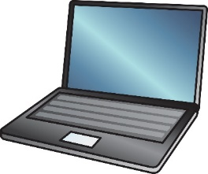
CS118: Lecture 1, Introduction, Layering
George Varghese
September, 2024
WORLDWIDE
INTERNET

Slide 2
Lecture Outline
Administration, Syllabus
Why Study Networking?
Packet Switching: Big idea 1
A Hats Analogy
Overview of a Web Transfer
Layering More Formally: Big Idea 2

Slide 3
SYLLABUS

Slide 4
Syllabus
Refer to Syllabus and Time Line
3 HWs (15%), Midterm (20%), Final (25%), Projects 0 (5%) 1 (15%), 2 (20%)
New topics: network security, cloud and container based networking
Deprecating old topics: Fourier Analysis, CRC theory
Bottom up (from Physical Up) with lots of top down overviews at start
Wait List Policy: No wait list unless people drop

Slide 5
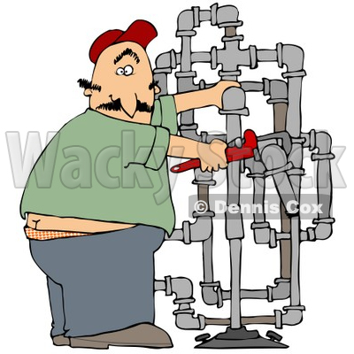
Is networking merely plumbing?
Network
Innovation?
Science?
Operator
Notes:
Is networking merely plumbing? What can possibly be cool about plumbing compared to deep learning and computation ecology? What is left to do after 40 years of Internet design besides mere engineering and tinkering? Where is the innovation? Where is the science

Slide 6
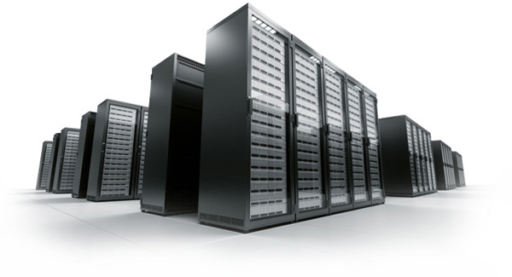



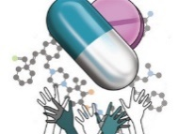



No, its the new computational bus . . .
DATA CENTER
NETWORK
Search
Shop
Stay
Ride
Design
Optimize
Notes:
First of all, data center networks are the new equivalent of computer buses of old that provides services: not just Google and Amazon but more recent innovative services like Airnb and Uber. But also they are the basis for the new supercomputers that power drug design say at Pfizer and optimization of say flights at Southwest, thus networks are an integral part of the infrastructure of many if not most of the Fortune 500 companies

Slide 7

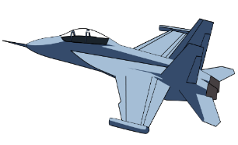
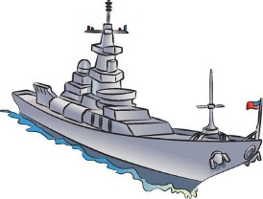
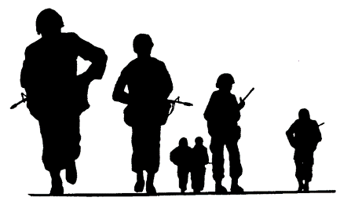

and the new agile battlefield network . . .
BATTLEFIELD
NETWORK
Drones
Planes
Ships
Troops
Command
Notes:
First of all, data center networks are the new equivalent of computer buses of old that provides services: not just Google and Amazon but more recent innovative services like Airnb and Uber. But also they are the basis for the new supercomputers that power drug design say at Pfizer and optimization of say flights at Southwest, thus networks are an integral part of the infrastructure of many if not most of the Fortune 500 companies

Slide 8





and still the world’s communication channel . . .
WORLDWIDE
INTERNET
Text
Blog
Video
Friend
Share
Notes:
First of all, data center networks are the new equivalent of computer buses of old that provides services: not just Google and Amazon but more recent innovative services like Airnb and Uber. But also they are the basis for the new supercomputers that power drug design say at Pfizer and optimization of say flights at Southwest, thus networks are an integral part of the infrastructure of many if not most of the Fortune 500 companies

Slide 9
SOME COOL FACTS. . .
June 2008 Google’s index of the web consists of 1 trillion unique URLs (but lots of chaff)
December 2012 Annual e-commerce sales top $1 trillion worldwide for the first time. (5.8 trillion in 2023)
February 2014 45% of internet users ages 18-29 in serious relationships say the internet has had an impact on their relationship.
Summer 2014 The number of Internet users worldwide reaches 3 billion. (5.4 billion, 64% of world)
November 2014 Only 23% of respondents to a Pew online survey know that the “the Internet” and the “the World Wide Web” do not refer to the same thing.
From “A Very Short History of The Internet, Gil Pres, in Forbes

Slide 10
So Why Study Networking?
Because its already part of your life: the computational bus for services you need and the communication channel to stay connected,
Because its the hip place to be: the Internet is constantly growing From geek (as opposed to greek) to you?
Cool work other than AI!. Google, Facebook, Uber, and even Airbnb are all hiring. Internet startups continue to redefine networking.
Now for a quick tour . . . Fasten your seatbelts

Slide 11
PACKET SWITCHING: THE NEW PARADIGM USED IN THE INTERNET

Slide 12
CIRCUIT SWITCHING
COMPUTER 1
Reserve 50 Mbps
Router 1
COMPUTER 3
Reserve 50 Mbps
Router 2
COMPUTER 2
Router 3
All links 100 Mbps
Way phone networks were built in 196Os and way AT&T wanted to do data

Slide 13
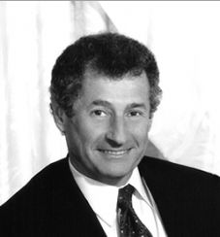
PACKET SWITCHING 1: Len KLEINROCK
COMPUTER 1
3, 1
Router 1
COMPUTER 3
3, 1
3, N
3, N
Router 2
COMPUTER N
Router 3
All links 100 Mbps
MIT PhD thesis: No reservations! Can multiplex more bursty traffic. Analysis

Slide 14
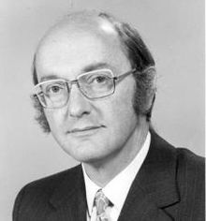
PACKET SWITCHING 2: DONALD DAVIES
Router 1
b
a
c
COMPUTER 3
c
a
Router 2
COMPUTER 1
Router 3
At England’s NPL: easier reliability. If packet b gets dropped, only repeat b

Slide 15
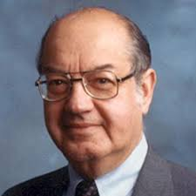

PACKET SWITCHING 3: PAUL BARAN
COMPUTER 1
Router 1
a
b
COMPUTER 3
c
Router 2
Router 3
COMPUTER N
Rand Report: More survivable. If enemy can attack some paths, can still send data

Slide 16
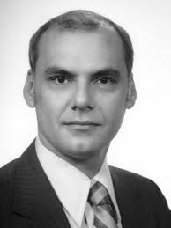
PACKET SWITCHING 4: LARRY ROBErTS
SRI
IMP 1
MIT
UTAH
IMP 2
IMP 3
UCLA
ARPA: Resource Sharing: could share expensive graphics computer at Utah
Contracts with BBN to build IMP and with UCLA to do measurement and first IMP
https://en.wikipedia.org/wiki/Packet_switching

Slide 17
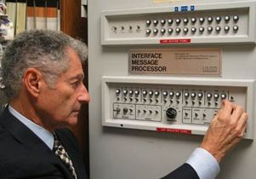
IN 1969 A UCLA TEAM LED BY LEN KLEINROCK SENT THE FIRST INTERNET MESSAGE VIA THE FIRST INTERNET ROUTER. VISIT 3420 BOELTER HALL

Slide 18


REVOLUTION 2: FROM 2002-2012 DEBORAH ESTRIN AND GREG POTTIE SET UP UCLA CENS THAT ANTICIPATED THE WIRELESS SENSOR NETWORK AGE

Slide 19
HAT TRANSFER ANALOGY

Slide 20
HAT TRANSFER ANALOGY
"A Plumed Hat, Please"
_{HAZELS} "3 Shipments of Plumed Hats"
HAZELS
HATS
"Check Inventory"
MOROCCO
BOSTON
BIGWIG IMPORT
BIGWIG
"Did shipment arrive?"
MOROCCO
EXPORT
"Whoa, too fast"
BOSTON
RIO
MOROCCO
POST
POST
POST
OFFICE
OFFICE
OFFICE
VARIG
VARIGB.S.
CASABLANCA
AIR
RIO RIO
BALLOON STATION
_{(LOGAN)} Airline
Balloon

Slide 21
MAIL FROM BOSTON TO PARIS
W/S
PARIS
Satellite
W/S
Ethernet
BOSTON

Slide 22
MAIL: POE TO PROUST
"Hi, Marcel"
POE’S
" New mail"
MARCEL’S
MAIL
MAIL
PROGRAM
PROGRAM
POE’S RANSPOR PROGRA | "Did message arrive?" | MARCEL TRANSPO PROGRA
 | "Whoa, too fast" M
’S
RT
T
T
M
POE’S
BOSTON
MARCEL’S
ROUTING _{ROUTER}
ROUTING PROGRAM
PROGRAM
ETHERNET
ETHER SAT.
SATELLITE
D.L.
I/F
I/F
D.L.
BOSTON
Ethernet
Satellite

Slide 23
Deeper Issues with the Analogy
Equivalents of Immigration and customs?
Equivalents of postage?
Chopping and changing: hats into slices as in Data Link?
Out-of-band versus in-band communication between layers
Discuss this

Slide 24
ANATOMY OF A WEB TRANSFER

Slide 25
Context 1: End Device Networking
A TYPICAL LAPTOP
MEMORY
KERNEL
 |  | socket
MAIL
CPU
DISK
CPU Bus
Ethernet Interface
WiFi Card
Monitor
Ethernet
Air

Slide 26
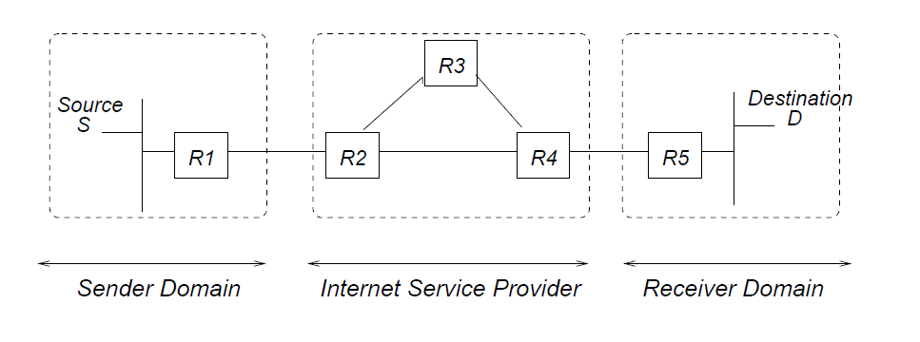
Context 2: IP Routing
Forwarding: routers forward packets based on looking up destination addresses in a forwarding table
Routing: Routers work together to build a forwarding table. OSPF (within domains), BGP (between ISPs)

Slide 27
A Web Transfer
Sender S
INTERNET
Receiver D
Application TCP
Connect to D
Send GET (20 bytes)
TCP Application
SYN-ACK X, Y
SYN (Start Connection) X
Ack 20 bytes
Send 20 bytes
Send RESPONSE
(2000 bytes)
Send 1500 bytes
Send 500 bytes
Resend 500 bytes
Ack 2000 bytes
FIN-ACK
FIN (Finish Connection)
FIN
FIN-ACK
Watch the steps next time you access a web page. Looking up host name, transferring data, etc.

Slide 28
LAYERING MORE FORMALLY

Slide 29
Layering
Recall that in Hazel’s Hats analogy, we simplified a complex task (transferring hats) by outsourcing reliable transmission to an import-export agency who in turn outsourced package delivery to the post office who in turn outsourced single-hop package transmission to a carrier etc.
Similarly, in networking, an email transfer is simplified by subcontracting reliable delivery to a transport like TCP who subcontracts packet delivery to the network layer who subcontracts to the Data Link etc.
This division of labor in networking is called layering. Each horizontal slice (layer) is given a number starting with 1 for physical, 2 for data link etc. While TCP only uses bottom 4 layers, most general model is OSI/ISO model shown next.

Slide 30
application
APDU
application
PSDU
presentation
PPDU
presentation
SSDU
session
SPDU
session
TSDU
transport
(e.g. TCP)
TPDU
transport
(segments)
NSDU
network
(e.g., IP)
NPDU
(packets)
network
DSDU
data link
DPDU
data link
(e.g.,Ethernet)
(frames)
PhSDU
physical
PhPDU
physical
(bits,symbols)
(e.g.,bits as voltages)
THE OSI MODEL: DATED BUT CONCEPTUALLY USEFUL

Slide 31
Layering concepts
Protocol: Rules governing horizontal
communication between peer layer entities.
Interface: Rules governing vertical communication between a Layer N entity and a Layer N+1 entity on the same computer.
PDU: Protocol Data Units are the messages that are exchanged between peer entities. N-PDU between Layer N-entities. In Internet, TPDU = Segment, NPDU = Packet, DPDU = Frame.
SDU: Data Unit passed across an interface.
N-SDU passed to and from layer N from Layer N+1.
PDU versus SDU: Normally, N-PDU is N-SDU together with a Layer N header. However, one SDU can be split into multiple PDUs if the protocol allows only small PDUs.

Slide 32
Watch those headers!
Communication between layer entities shares physical medium by using a layer header for each layer in each message. Think of data in envelope with transport header, stuffed in envelope with routing header, stuffed in enevelope with DL header.
Sharing headers saves postage and also trivially coordinates headers with corresponding data (compared to out-of-band transmission between layers).
Strict Layering: Each layer only looks at its header and interface data to do its job. Software engineering: changes to one layer do not cause other layers to be reimplemented. Information can be passed between layers via interface.
As data moves down the layers, each layer adds its header. As data moves up, each layer strips off its header.

Slide 33
Source
Router
Destination
application
presentation
session (null)
transport
network
data link
physical
AH
application
presentation
session (null)
transport
network
data link
physical
AH
AH
AH
AH
AH
TH AH
TH AH
NH TH AH
NH TH AH
DH NH TH AH
DH NH TH AH
DH NH TH AH
DH NH TH AH
NH TH AH
network
data link
physical
NH TH AH
DH NH TH AH
DH NH TH AH
DH NH TH AH
DH NH TH AH
HEADERS: WATCH HOW THEY ARE ADDED AND REMOVED. STRICT LAYERING – THE DEFINITION

Slide 34
LAYERING IS MODULAR DESIGN
Sub-divide the problem
Each layer relies on services from layer below
Each layer exports services to layer above
Interface between layers defines interaction
Hides implementation details (encapsulation)
Layers can change without disturbing other layers (modularity)
Interface among peers in a layer is a protocol
If peers speak same protocol, they can interoperate

Slide 35
KEY DESIGN DECISION IN IP
How do you divide functionality across the layers?
End-to-end argument [Saltzer84]
Functionality should be implemented at a lower layer iff it can be correctly and completely implemented there. Incomplete versions of a function can be used as a performance enhancement, but not for correctness
Early, and still relevant, example
ARPAnet provided reliable link transfers
Was this enough for reliable communication?
No, packets could still get corrupted on host-switch link, or inside of the switches
Hence, still need reliability at higher layers (TCP)

Slide 36
TCP SUCCESSFUL > 40 years
FTP
HTTP
Video
Applications
TCP
UDP
Transport
IP
“Thin Waist”
Fiber
Network
Cable
Data Link
Wireless
Physical
Innovation? Science?
The Hourglass Model
Q: Why was TCP/IP successful?
A: IP addressing (Lecture 12)
Socket interface (Lecture 17)
Notes:
Is networking merely plumbing? What can possibly be cool about plumbing compared to deep learning and computation ecology? What is left to do after 40 years of Internet design besides mere engineering and tinkering? Where is the innovation? Where is the science

Slide 37
Copy File F at S
to File F at D
S
R1
R2
D
User Interface
Write (m) to connection queue
Read (m)
Transport (TCP)
Interface
^{F}6-8 | ^{F}2-5 | F₁
Send (segment) to D
Receive (segment)
Routing (IP) Interface
S
R1
R2
D
other paths?
Send (packet)
Receive (packet)
Data Link Interface
R1
R2
Send (bit)
Receive (bit)
Physical Layer Interface
THE IP ABSTRACTIONS: Each layer provides a service to the layer above it

Slide 38
From Files to Voltage Levels
File Transfer implemented by two FTP processes on each machine. Shared queue is simplest asynchronous interface, which is what TCP provides.
TCP implements shared queue abstraction by sending numbered segments, retransmitting if acks are not received. Requires being able to send segments to arbitrary destinations, which is what IP provides.
IP computes routes (routing) and then forwards packet hop-by-hop. At each hop, IP requires sending a frame to directly connected neighbor, which is what Data Link provides.
Data Link uses physical layer to send each bit of a frame; then puts together bits at receiver to form a frame and does error checks. Physical layer sends bits by transforming 0s and 1s into physical energy that can travel distance.

Slide 39
So why a 20 lecture class?
All layers have common problems: synchronization in the face of errors and asynchrony, addressing, multiplexing, interconnection. Sample problems you will learn the answer to:
Transport:
Congestion Control. How does a TCP sender know how to speed up or slow down depending on current Internet speed? Slow-start.
Connection Management: How does TCP prevent old conversations between the same pair of machines from mixing in with new conversations. 3-way handshakes
Routing:
CIDR: How does IP allow various sizes of networks in allocating addresses.
BGP: How does IP calculate routes between multiple competing providers?

Slide 40
Data Link:
Min Packet Sizes: How does Ethernet ensure that if one nodes detects a collision, all nodes do?
Dynamic Backoff: How can Ethernet sort out 2 sender collisions quickly while being able to sort out even 32 sender collisions?
Physical Layer:
Clock Recovery: How does a receiver reconstruct bits from physical signals despite speed differences?
Media Issues: When should a manager use wireless versus fiber versus satellite?

Slide 41
LECTUre 1 EPILOG: Feynman on Physics
We have a way of discussing the world, when we talk of it at various hierarchies, or levels . . . I will indicate, by describing a set of ideas, what I mean by hierarchies of ideas.
The great mass of workers in between, connecting one step to another, are improving all the time our understanding of the world, . . . and in that way we are gradually understanding this tremendous world of interconnecting hierarchies.
Which End Is Closer To God?
Richard Feynman

